Slide 1
Serial Communication

Slide 2
Introduction to Serial Communication
Serial communication is data transmission one bit at a time over a single line.
Parallel communication (multiple bits simultaneously on multiple wires)
Key Idea:
Serial → simple, low wiring, reliable
Parallel → faster but complex and costly

Slide 3
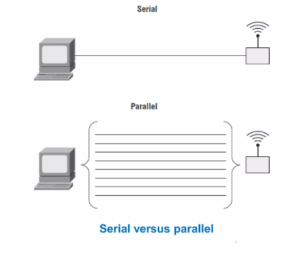

Slide 4
Serial vs Parallel Communication
Feature | Serial | Parallel
Data transfer | One bit at a time | Multiple bits simultaneously
Wires required | Few | Many
Cost | Low | High
Distance | Longer | Limited
Complexity | Simple | Complex

Slide 5
Basic Serial Communication Concept
It Uses two main lines:
TX (Transmit)
RX (Receive)
Working:
TX of device A → RX of device B
RX of device A → TX of device B

Slide 6
Serial Communication in Arduino
Arduino communicates with:
Computer (via USB)
Other devices (sensors, modules)
Important Points:
Uses pins 0 (RX) and 1 (TX)
USB is internally connected to these pins
These pins cannot be used for I/O when serial is active

Slide 7
What Happens Internally When Serial Data is Sent?
When Arduino sends data:
Data (character/number) is converted into binary form
Binary data is placed inside a frame structure
Bits are shifted out sequentially using a shift register
Electrical voltage levels represent 0s and 1s
Receiver reconstructs the original data from bit stream
Communication happens at hardware register level inside the microcontroller.

Slide 8
Frame Structure in Serial Communication
Each transmitted character is packed into a frame:
Start Bit | Data Bits | Parity Bit (optional) | Stop Bit(s)
Components:
Start Bit (1 bit)
Always LOW (0)
Indicates beginning of transmission
Data Bits (5–9 bits)
Usually 8 bits
Contains actual data
Parity Bit (optional)
Used for error detection
Even or Odd parity
Stop Bit (1 or 2 bits)
Always HIGH (1)
Marks end of frame

Slide 9
Starting Serial Communication
Function:
Serial.begin(9600);
Explanation:
Initializes serial communication
9600 = baud rate (bits per second)
Both devices must use the same baud rate

Slide 10
Sending Data (Serial Output)
Functions:
Serial.print("Hello"); Serial.println("World");
Difference:
print() → same line
println() → new line
Used for:
Debugging
Monitoring sensor values

Slide 11
Example: Sending Data (LED Status)
void setup() { pinMode(13, OUTPUT); Serial.begin(9600); } void loop() { digitalWrite(13, HIGH); Serial.println("LED is On"); delay(1000); digitalWrite(13, LOW); Serial.println("LED is Off"); delay(1000); }

Slide 12
Receiving Data (Serial Input)
Function:
Serial.read();
Explanation:
Reads incoming data from serial buffer

Slide 13
Controlling LED via Serial Input
int ledPin = 13; int value; void setup() { Serial.begin(9600); pinMode(ledPin, OUTPUT); } void loop() { value = Serial.read(); if (value == '1') { digitalWrite(ledPin, HIGH); } else if (value == '0') { digitalWrite(ledPin, LOW); } }

Slide 14
Important Serial Functions
Function | Purpose
Serial.begin() | Start communication
Serial.print() | Send data
Serial.println() | Send data with newline
Serial.read() | Read incoming data
Serial.available() | Check data availability
Serial.flush() | Wait for transmission completion

Slide 15
Advantages
Less wiring
Long-distance communication
Low cost
Simple implementation

